Slide 1




Slide 2

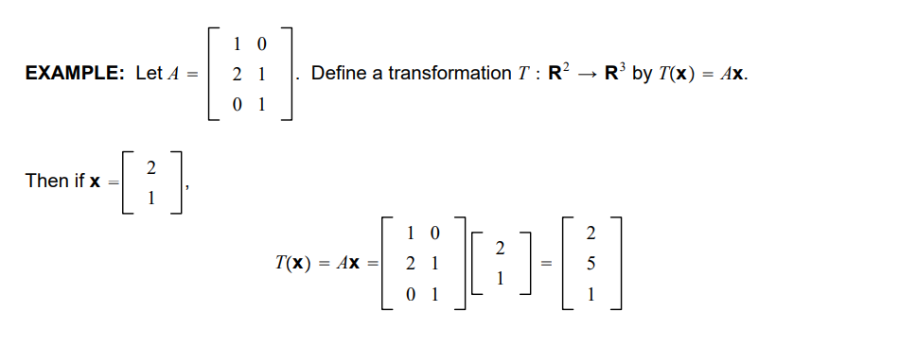

Slide 3



Slide 4


Slide 5

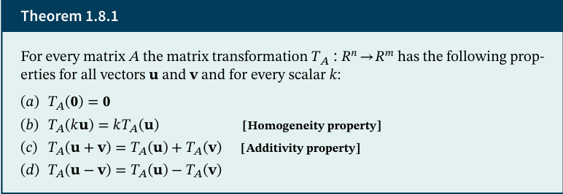

Slide 6


Slide 7



The standard matrix for a linear transformation 𝑇∶$R^{n}$→$R^{m}$ is

Slide 8

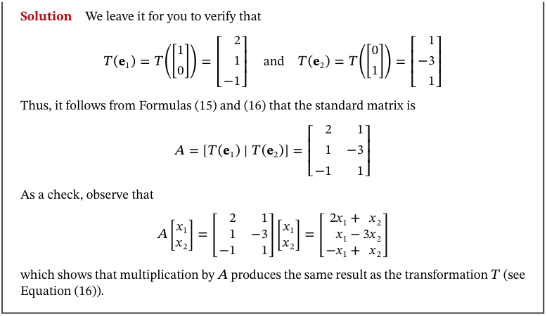

Slide 9
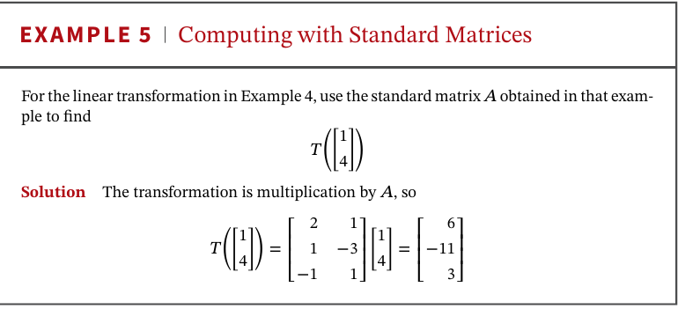

Slide 10
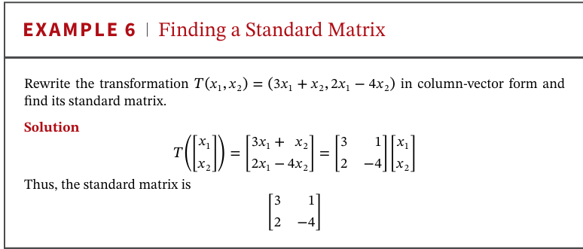

Slide 11


Slide 12
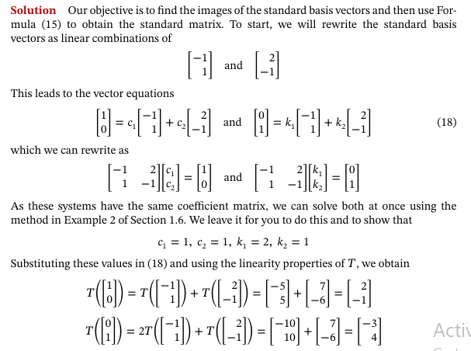


Slide 13

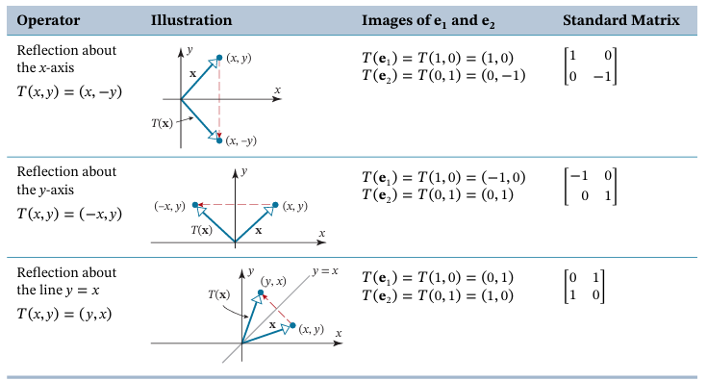

Slide 14
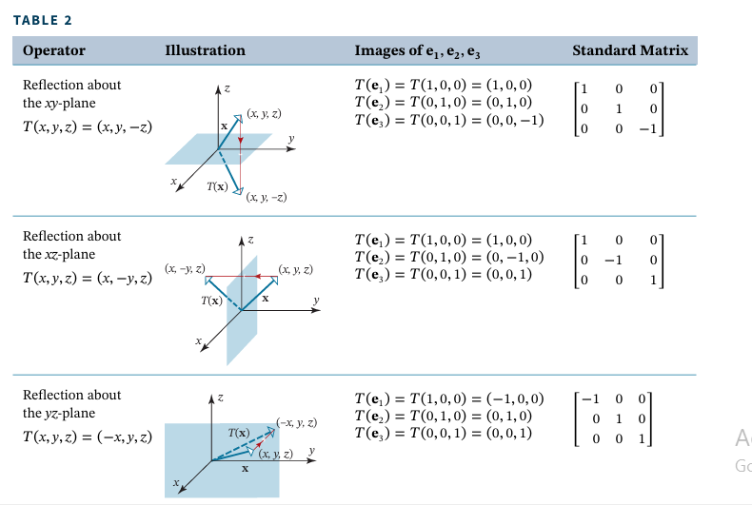

Slide 15

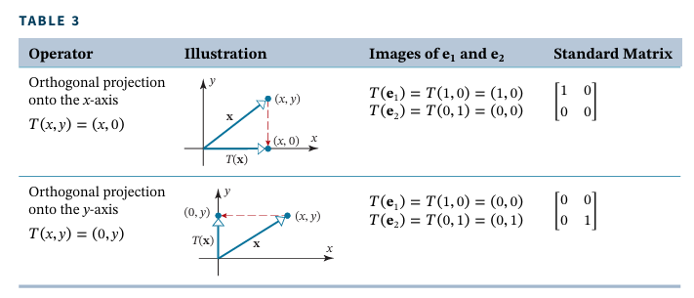

Slide 16
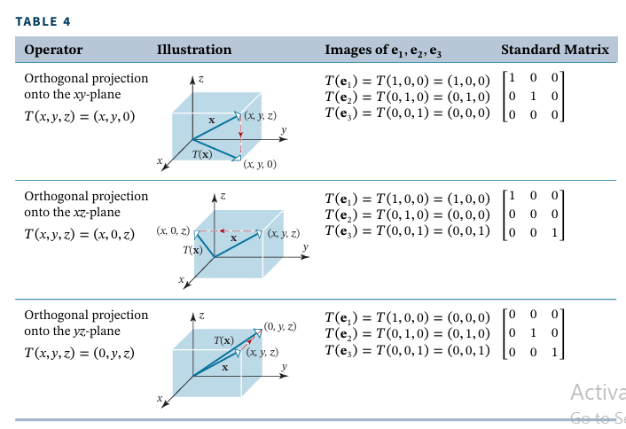

Slide 17



Matrix operators on $R^{2}$that move points along arcs of circles centered at the origin are called rotation operators.

Slide 18
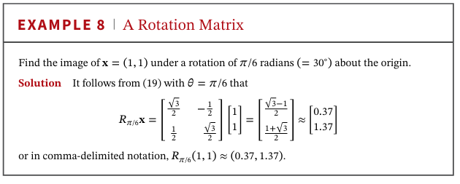

Slide 19



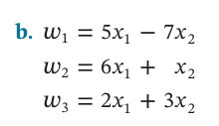

Slide 20




Slide 21

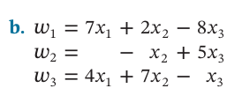



Slide 22





